Slide 1
Explaining Credit Card Fraud Decisions in ML
A Comparative Analysis of XAI Methods (in Neural Network Models)
Ciaran Finnegan – Course: M.Sc. in Computing (Data Science)
Student: D21124026
Notes:
Title : Utilizing Explainable AI Techniques in Explaining Credit Card Fraud Detection Decisions in Neural Network Models: A Comparative Analysis
As you can see here - my dissertation was on research, experimentation and analysis of explanations generated on credit card fraud decisions. It’s a comparative analysis of of explainer techniques used with a neural network model built for binary fraud classification.

Slide 2
Motivation
How to propose developments in the assessment of ‘explainability’ techniques in credit card fraud
Notes:
I’m starting with a very brief explanation of why I choose this area of research, as I believe it frame the motivation and approach I followed in this thesis.

Slide 3

Motivation
Background of interest/professional involvement in the application of ML to financial crime prevention software.
Access to new and ‘almost real’ world credit card fraud data on which to experiment and test hypotheses.
Emerging Product Management interest around integrating ‘explainability’ in fraud detection model output.
This includes assessing the benefits of different techniques.
Notes:
To explain my background – I have ~30 years' experience in software development and testing; but the last 20 very specifically in the area of financial crime prevention.
I have peripherally been involved and interested in advance with ML over the last 8 years or so and tried to keep pace with work that my colleagues have been doing in this area – hence the access to internal datasets specialising in credit card fraud – more on that later.
Somewhat serendipitously, at the same time in late 2022 my company was acquired by SymponyAI (who are more advanced in using ML techniques for financial crime software) at the same time that I was taking the module on Research Design and Proposal Writing (Dr Luca Longo). So, I was hearing suggested future roadmap plans from new Product Designers on the greater use of explainability techniques at the same time Dr Longo’s class was providing some guidance in this area as I was trying to shape my dissertation.
Since then, our Product has not done made major enhancements beyond the use of SHAP values, but I got to know some of the Product designers and XAI came up as a future topic for enhancement, which led me into looking at this topic much further and the idea of a comparative analysis in the financial crime domain.

Slide 4
Background + Literature Review
Key themes in current research
Notes:
I already mentioned the module on Research Design and Proposal Writing (Dr Luca Longo) and obviously as I was gravitating towards the topic of XAI in credit card fraud detection I began researching the existing literature on the topic.

Slide 5
Background and Literature Review
Key Themes
It is not enough to stop the fraud; the machine needs to tell you why?
How to measure the effectiveness of an explanation? What makes it good? Consensus is hard to find.
Humans can give you their assessments – but they can be expensive, stupid, or prejudiced (or all three).
Can the value of XAI output, particularly from an NN ‘black box’, be assessed using an objective/statistical process?
There are examples of ML research in the area of objective XAI comparisons in the Healthcare domain; can this be applied to CC Fraud?
Notes:
I know the intention of this presentation is not focus to heavily on the literature review but to quickly synopsise the themes and inspiration from my review…
It’s hard NOT to find a paper that doesn’t throw in some comment in the intro about the need to unpick the inner workings of a ‘black box’ ML mode and explain why. EU law is pushy on the need to explain why an automated decision is made about a citizen and why a credit card transaction gets flaged as ‘fraud’.
There is still a significant amount of subjectivity about the definition of a good explanation – there is frequent use of survey of human opinion on the explanations. Without being too flippant; using real people is a problem because they are expensive, stupid (lack of domain knowledge) or biased.
Very, very deliberately I decided early on that I wanted to avoid human interaction and build an objective comparison model of different XAI techniques for credit card fraud.
Very much influenced by a 2020 paper called ‘Interpretability in healthcare: A comparative study of local machine learning interpretability techniques’ -- Radwa ElShawi1 Youssef Sherif1 Mouaz Al-Mallah2 Sherif Sakr1. I will elaborate in the following slides about where this inspiration led me – but although I could find other simailrish work with Healthcare data there was nothing obviously comparable in the same way for credit card fraud (or more general financial crime topics).

Slide 6
Chosen Research Problem
An objective analysis of XAI techniques in card fraud detection/explanation
Notes:
So let me refine in a more formal way what I decided was going to be the research objective for this thesis….

Slide 7
Research Problem – Automate XAI Method Evaluation?
Null Hypothesis:
It is not possible to quantify and distinguish the statistically best interpretation framework to explain the reason for a specific (local) credit card fraud classification result using the following state-of-the-art techniques; SHAP, LIME, ANCHORS, and DICE.
Alternate Hypothesis:
IF a Neural Network algorithm is trained on a credit card transaction dataset for ML fraud detection, and SHAP, LIME, ANCHORS, and DICE interpretability frameworks are applied to individual model results
THEN a test for significance can be applied to the scores of each interpretability framework, against a predefined set of quality metrics, to rank each explainer technique and to demonstrate statistically which is best for explaining local credit card fraud classification results.
Notes:
This is taken from the thesis – if I simply - I wanted to take four XAI techniques and using a set of custom metrics feed this data into a statistical analysis and determine if one could be objectively quantified as ‘the best’ for this particular credit card fraud classification problem.
I am conscious that I do not need to explain to this audience how these explainers work but if you will allow me, it does help focus my thoughts, and I will give a quick overview of each – and then I will elaborate in more detail about the ‘pre-defined custom metrics’ I created…
Also, I am only considering local post-hoc explanations – so just explanations for specific credit card transaction classifications; not looking at the global model properties

Slide 8
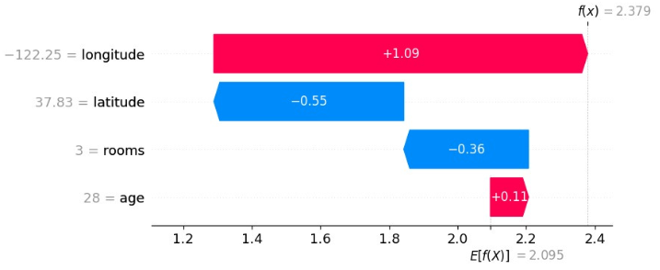
Research Problem – Automate XAI Method Evaluation?
Null Hypothesis:
It is not possible to quantify and distinguish the statistically best interpretation framework to explain the reason for a specific (local) credit card fraud classification result using the following state-of-the-art techniques; SHAP, LIME, ANCHORS, and DICE.
Alternate Hypothesis:
IF a Neural Network algorithm is trained on a credit card transaction dataset for ML fraud detection, and SHAP, LIME, ANCHORS, and DICE interpretability frameworks are applied to individual model results
THEN a test for significance can be applied to the scores of each interpretability framework, against a predefined set of quality metrics, to rank each explainer technique and to demonstrate statistically which is best for explaining local credit card fraud classification results.
SHAP - SHapley Additive exPlanations – The contribution of each feature to the final verdict for individual predictions.
Notes:
First up, SHAP values – I the financial crime products I have seen in this domain SHAP values are fairly ubiquitous. One might argue that part of this comparative analysis is to answer why you might use anything else?
SHapley Additive exPlanations, is like a detective that breaks down exactly how an AI model makes its decisions, showing us the contribution of each feature to the final verdict for individual predictions. It’s a bit like getting a detailed recipe of how a decision was cooked up, making the often-mysterious AI thought process a lot more transparent and understandable.

Slide 9
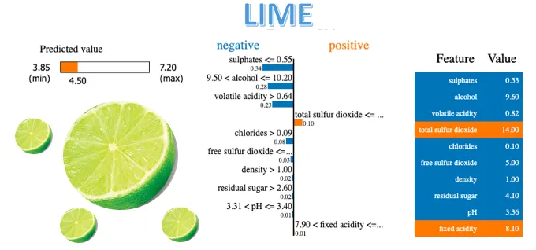
Research Problem – Automate XAI Method Evaluation?
Null Hypothesis:
It is not possible to quantify and distinguish the statistically best interpretation framework to explain the reason for a specific (local) credit card fraud classification result using the following state-of-the-art techniques; SHAP, LIME, ANCHORS, and DICE.
Alternate Hypothesis:
IF a Neural Network algorithm is trained on a credit card transaction dataset for ML fraud detection, and SHAP, LIME, LIME, ANCHORS, and DICE interpretability frameworks are applied to individual model results
THEN a test for significance can be applied to the scores of each interpretability framework, against a predefined set of quality metrics, to rank each explainer technique and to demonstrate statistically which is best for explaining local credit card fraud classification results.
LIME - Local Interpreable Model-agnostic Explanations – Again focusing on one decision at a time, this approach creates a simpler model approximating how the original model prediction behaves.
Notes:
Again, not uncommon in financial crime Products…
LIME, or Local Interpretable Model-agnostic Explanations, acts like a translator, simplifying the complex language of AI decisions into something we can easily understand, focusing on one decision at a time. It creates a simpler model that approximates how the original, complex model behaves for individual predictions, giving us a peek into the black box to see what's influencing its choices.
LIME serves as a methodology for demystifying the decision-making processes of complex machine learning models on a case-by-case basis. It operates by approximating the original model's behaviour with a simpler, interpretable model around the vicinity of a particular instance, thereby providing insights into the contributions of different features towards the prediction outcome. This approach not only enhances transparency but also aids in validating the reliability and fairness of the model's predictions, crucial for academic research and practical applications in sensitive fields.
Think of SHAP and LIME as two friends who help you understand the mysterious decisions made by AI, but they go about it in slightly different ways. SHAP is like the friend who gives you the complete breakdown of every little contribution to the decision, based on game theory, ensuring fairness in how each feature's impact is calculated. On the other hand, LIME takes a more localized approach, creating simple, easy-to-understand models for specific predictions to show you what's happening under the hood. So, while SHAP gives you the big, detailed picture based on solid principles, LIME zooms in on individual cases with a simpler explanation model, making it super handy for spot checks.

Slide 10
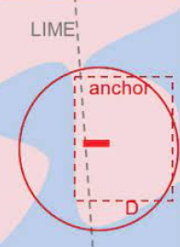
Research Problem – Automate XAI Method Evaluation?
Null Hypothesis:
It is not possible to quantify and distinguish the statistically best interpretation framework to explain the reason for a specific (local) credit card fraud classification result using the following state-of-the-art techniques; SHAP, LIME, ANCHORS, and DICE.
Alternate Hypothesis:
IF a Neural Network algorithm is trained on a credit card transaction dataset for ML fraud detection, and SHAP, LIME, ANCHORS, and DICE interpretability frameworks are applied to individual model results
THEN a test for significance can be applied to the scores of each interpretability framework, against a predefined set of quality metrics, to rank each explainer technique and to demonstrate statistically which is best for explaining local credit card fraud classification results.
ANCHORS - Feature specific explanations (‘if-then’ rules) for individual instance, that identify a minimal set of conditions or ‘anchors’ that ensure the same prediction for similar instances.
Notes:
ANCHOR: identifying minimal sets of conditions, or 'anchors', that are sufficient to ensure the same prediction for similar instances
In the context of credit card fraud detection, an "Anchor" could be a specific set of transaction characteristics that, when present, almost always indicate a fraudulent transaction according to the model. For example, an Anchor might be: "If a transaction is over $2000, occurs in a foreign country, and happens between 2 AM and 5 AM local time of the cardholder, then it is flagged as fraud." This rule acts as a clear explanation, showing under what conditions the model is confident in predicting fraud, providing transparency into the decision-making process.
The ANCHOR method is like having a trusty guide that highlights the 'sure thing' reasons behind an AI's decision for a specific case, pinpointing the conditions under which the model's prediction would stay the same. It's as if you're getting a set of rules that, when followed, guarantee the AI will arrive at the same conclusion every time, offering a clear window into the model's reasoning in particular scenarios.
The ANCHOR method for explainable AI (XAI) generates explanations by identifying and presenting a set of conditions or features that, when present, reliably predict the outcome of a model's decision for a specific instance. This approach effectively delineates the "if-then" rules that are pivotal for the model’s prediction, ensuring a high degree of certainty and interpretability. By furnishing these anchors, the method facilitates a deeper understanding of the model's behaviour in localized contexts, offering insights into the deterministic aspects of its decision-making process.

Slide 11
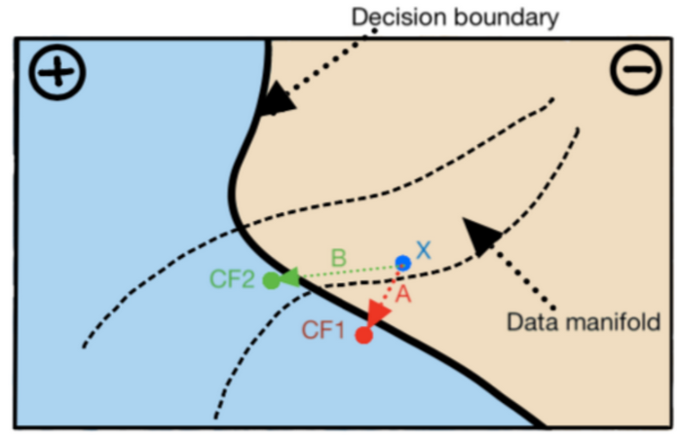
Research Problem – Automate XAI Method Evaluation?
Null Hypothesis:
It is not possible to quantify and distinguish the statistically best interpretation framework to explain the reason for a specific (local) credit card fraud classification result using the following state-of-the-art techniques; SHAP, LIME, ANCHORS, and DiCE.
Alternate Hypothesis:
IF a Neural Network algorithm is trained on a credit card transaction dataset for ML fraud detection, and SHAP, LIME, ANCHORS, and DiCE interpretability frameworks are applied to individual model results
THEN a test for significance can be applied to the scores of each interpretability framework, against a predefined set of quality metrics, to rank each explainer technique and to demonstrate statistically which is best for explaining local credit card fraud classification results.
DiCE - Diverse Counterfactual Explanations – Provides the minimal set of changes required to alter the instance prediction. Provides insights into model sensitivity and decision boundaries.
Notes:
DiCE, standing for Diverse Counterfactual Explanations, is like a creative friend who helps you understand AI decisions by showing you alternative scenarios.
It answers the question, "What could have been changed in the input data to get a different outcome?" by generating examples that are close to the original data but would lead to a different decision, making it easier to grasp how and why the model arrives at its conclusions. Basically, what is the minimal changes that would flip the fraud classification in this data.
DiCE is a method in the realm of explainable AI (XAI) that facilitates understanding of model decisions by generating counterfactual instances. These instances represent minimal changes needed to alter the outcome of a prediction, thereby providing insights into the specific conditions under which the model's decision would change. By offering a set of diverse counterfactuals, DiCE helps in comprehensively exploring the decision space around a particular prediction, enhancing the interpretability of complex machine learning models through a clear illustration of the causal relationships within the data.
In the domain of credit card fraud detection, a DiCE counterfactual explanation might illustrate a scenario like this: Suppose a transaction is flagged as fraudulent by the model. A DiCE counterfactual could then provide an example where, if the transaction amount were lower (say, under $100 instead of over $500), occurred at a different time (e.g., midday instead of late at night), and was made at a location where the cardholder frequently shops, the model would not have flagged it as fraud. This counterfactual explanation helps to understand the specific conditions under which a transaction is considered suspicious by the model, offering clear insights into how changing certain features of the transaction could lead to a different outcome.

Slide 12
Experiments
Design and Methodology
Notes:
So, we’ve looked at the interpretability methods I choose to compare, but how will I actually implement the comparisons?
In the next slides I am going to explain how I defined a set of custom metrics to provides the input into the statistical analysis, which is an attempt to score the XAI techniques – see which one is ‘the best’ and if any ranking can be applied (or not obviously)
As a reminder the NULL Hypothesis is that we CANNOT statistically distinguish the XAI techniques…

Slide 13


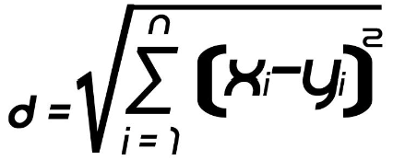
XAI: Set Up Model + Verify XAI Methods
XAI: Custom Metrics to Score Each Technique
Metric 1: IDENTITY
How many identical instances have identical explanations?
Use distance to find most similar instances -- associated explanations are also closest in distance.
Build a performant NN CC Fraud predictive model with dataset.
Prove XAI methods produce meaningful explanations.
Score each XAI technique against a set of custom-built metrics (inspired by similar ML experiment with Healthcare data).
Instance X
Closest
Instance Y
Explanation X
Closest
Explanation Y
Notes:
First point; took CC dataset from work – elaborate? It is artificial but was built up from a number of real-world client sources in the US. (See how we are doing for time) Built a NN model – again this is about explanations from ‘black boxes’.
The Experiments start with a check that my dataset would produce meaningful explanations – built initial framework on German Credit Default dataset; I will elaborate later why it was necessary to conduct a manual inspection of the XAI output on my CC data.
Looked at… Interpretability in healthcare: A comparative study of local machine learning interpretability techniques -- Radwa ElShawi1 Youssef Sherif1 Mouaz Al-Mallah2 Sherif Sakr1 and other slightly similar research to build my own metrics - TRANSITION
It said, “For every two instances in the testing data, if the distance between features is equal to zero, then the distance between the explanations should be equal to zero.”
I amended it to…read bullet points…explain diagram..
- Start with first instance in test data
- Search all other instances in test data and calculate distance from first instance (feature distance)
- Select closest other instance to first instance, i
- Generate explanations for all instances in test data
- Calculate distance of first instance explanations from explanations in all other instances
- Select closest other instance to first instance (explanation distance), t
- Generate success if instance id (i) = instance id (t)
- Drop first instance from test data

Slide 14
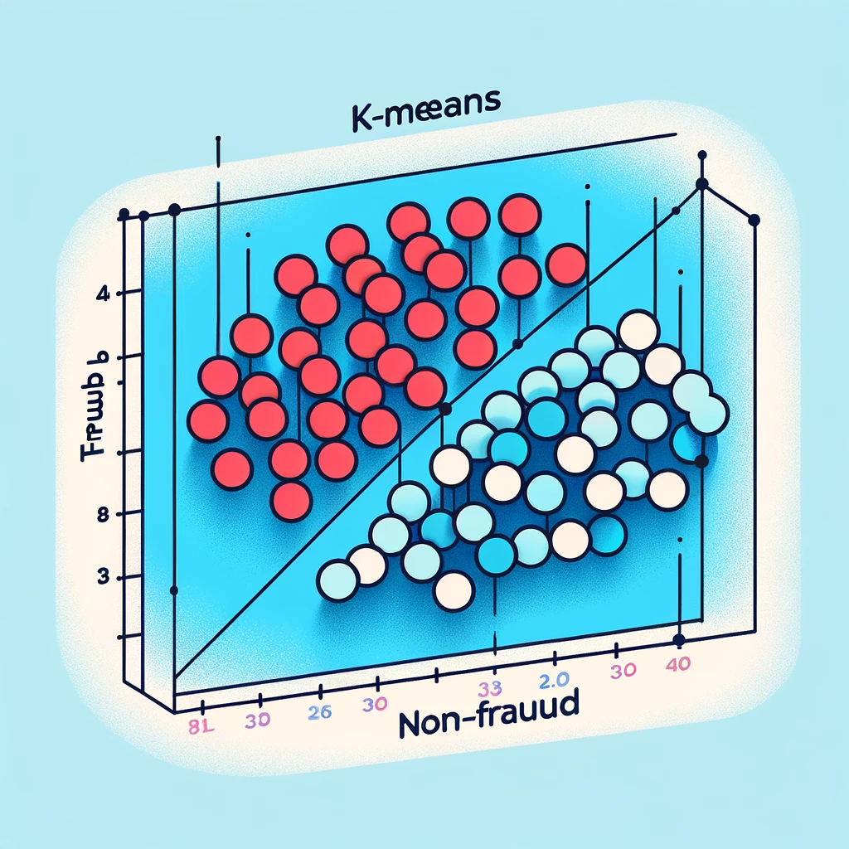
XAI: Custom Metrics to Score Each Technique
Metric 2: STABILITY
Instances belonging to the same class have comparable explanations.
Explanations cluster in correct ‘Fraud’/’Non-Fraud’ clusters, based on instance label.
Build a performant NN CC Fraud predictive model with dataset.
Prove XAI methods produce meaningful explanations.
Score each XAI technique against a set of custom-built metrics (inspired by similar ML experiment with Healthcare data).
Cluster Explanations.
Compare explanation cluster label to predicted class form associated instance.
Count number of matches (STABILITY criteria satisfied).
Notes:
Ok, the next metric is Stability…CLICK – no more clicks as the rest of the transitions are automatic
Stability: This metric states that instances belong to the same class must have comparable explanations.
K-means clustering is applied to the EXPLANATIONS for each instance in the test data. Measure the number of explanations in both clusters (fraud/non-fraud) that match the predicted class.
Measuring the stability metric is done by clustering the explanations of all instances in the testing data set using K-means clustering algorithm such that the number of clusters equals to the number of labels of the data set. For each instance in the testing data set, we compare the cluster label assigned to its explanation after clustering with the instance’s predicted class label and if they match then this explanation satisfies the stability metric.

Slide 15


XAI: Custom Metrics to Score Each Technique
Metric 3: SEPERABILITY
Dissimilar instances must have dissimilar explanations.
Build a performant NN CC Fraud predictive model with dataset.
Prove XAI methods produce meaningful explanations.
Score each XAI technique against a set of custom-built metrics (inspired by similar ML experiment with Healthcare data).
1: Remove Instance Duplicates
2: Check Explanation Duplicates
3: Count Separability ‘Success’ for Each Explanation
Notes:
Ok, the next metric is SEPERABILITY…CLICK – no more clicks as the rest of the transitions are automatic
Separability: This metric states that if there are two dissimilar instances, then they must have dissimilar explanations. This metric holds the assumption that the model does not have degree of freedom;27 this means that all the features used in the model are relevant to the prediction.
To measure the separability metric,we choose a subset S of the testing data set that has no duplicates and get their explanations. Then for every instance s in S,we compare its explanation with all other explanations of instances in S and if such explanation has no duplicate then it satisfies the separability metric.
Choose subset S of test data
- ensure no duplicate instances exist. This is a comparison of features, as no explanations have been generated yet. - remove any instances with duplicated features - generate explanations for each remaining instance in the subset of test data
For every instance in S
- compare explanations with all other instance explanations - if no duplicates are found; mark instance as 'success'

Slide 16
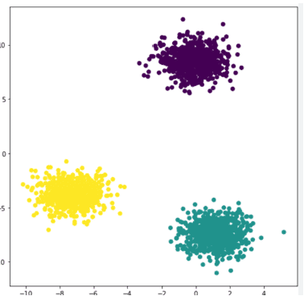
XAI: Custom Metrics to Score Each Technique
Metric 4: SIMILARITY
The more similar the instances, the closer their explanations are to each other.
Build a performant NN CC Fraud predictive model with dataset.
Prove XAI methods produce meaningful explanations.
Score each XAI technique against a set of custom-built metrics (inspired by similar ML experiment with Healthcare data).
Explanation
Explanation
Explanation
Explanation
2: Mean Pairwise Dist
Closest
Explanation
Explanation
1: Cluster Instances
Explanation
2: Mean Pairwise Dist
Explanation
Explanation
2: Mean Pairwise Dist
Explanation
Explanation
Explanation
Explanation
Closest
Explanation
Explanation
Explanation
Explanation
Explanation
Explanation
Closest
Explanation
Explanation
3: Mean Dist Score (All Groups)
Explanation
Explanation
Explanation
Notes:
Ok, the next metric is SIMILARITY…CLICK – no more clicks as the rest of the transitions are automatic
Similarity: This metric states that the more similar the instances to be explained, the closer their explanations should be and vice versa
To measure the similarity metric, we cluster instances in the testing data set, after normalization using DBSCAN algorithm. For each framework, we normalize the explanations and calculate the mean pairwise Euclidean distances between explanations of testing instances in the same cluster. The framework with the smallest mean pairwise Euclidean distances across its clusters is the best reflecting the similarity metric score – the more similar the instances to be explained, the closer their explanations should be and vice versa.
# Option code to look at optimising cluster values optimal_clusters = determine_optimal_clusters_davies_bouldin(features_df)
Not a % score – the average pairwise Euclidean distance for each group of explanations.

Slide 17


XAI: Custom Metrics to Score Each Technique
Metric 5: COMPUTATIONAL EFFICIENCY
Time taken to generate a set of explanations.
Why included? Relevant metrics for commercial applications.
The ‘scores’ from each XAI experiment provide the input to a statistical analysis experiment.
This experiment assesses if there is any significant difference between the performance of the XAI techniques.
Notes:
Ok, the next metric is Computational Efficicency…CLICK – the two more clicks for the text after time image appears
2. Time: This metric represents the average time taken by the interpretability framework to output an explanation.
This was challenged as a metric, but I believe it is a valid metric for consideration in a commercial system.
Check specification of Azure Kubeflow Notebooks…
On click – all these output scores from the metrics feed into a statistical comparison and results output/analysis/conclusion

Slide 18
Experiments: Implementation
Generating and evaluating XAI custom metrics
Notes:
That was an overview of the design, the actual implementation looks like this… TRANSITION

Slide 19
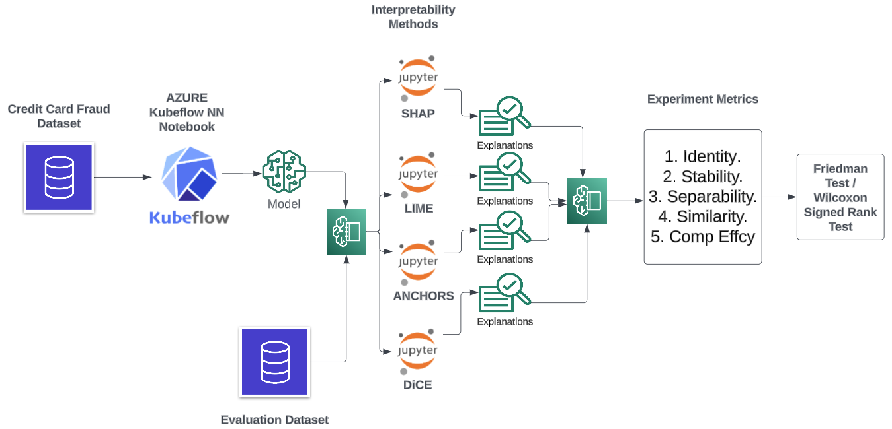
Experiment Structure
Implemented as a modular framework of Python files.
NN Model built from training data split.
XAI explainers built from training/test/full dataset, as required by each given implementation library.
Test data (in ‘chunks’) used to generate actual explanations for scoring.
Score date fed into analysis and processed (also a Python .ipynb file)
https://github.com/JackDaedalus/Dissertation.git
Notes:
Used a Kubeflow environment to build up a series of Python notebooks to execute the stages/steps in the experiments.
Aimed to follow good software engineering practice and build as modular a framework as possible, separating out the logic that;
builds the model,
from the individual XAI techniques generating the explainers
To the functions that actual do the metric scoring
To the code that conducts and presents the statistical analysis
The idea was to make the codebase as extensible as possible – the link is on screen to my GitHub repo (included in Thesis appendices)
I will explain in a moment why it was necessary to break the input Test data into ‘chunks’ before generating the explanations.

Slide 20
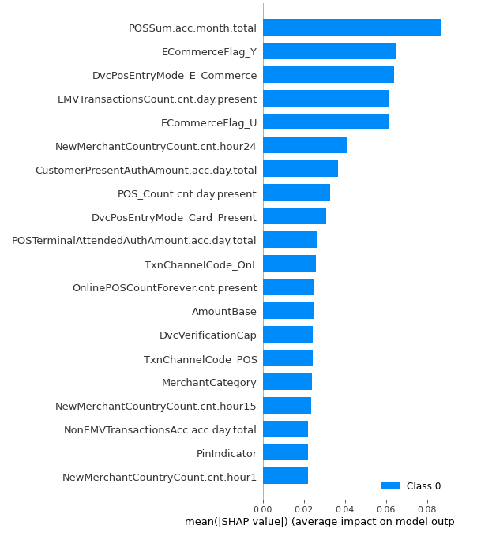
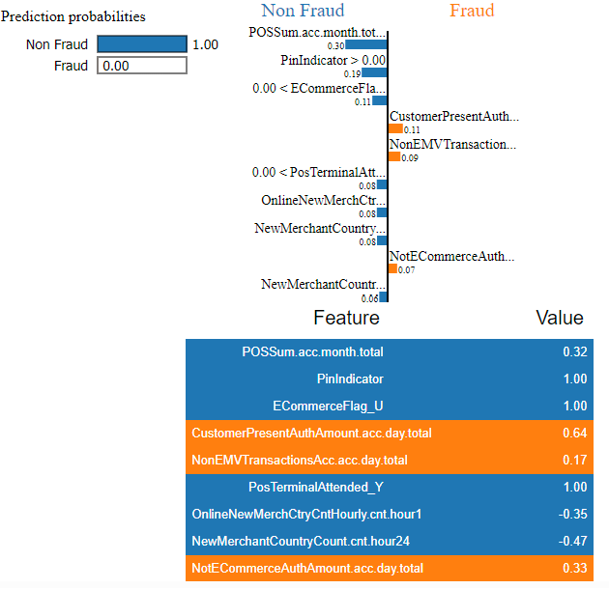
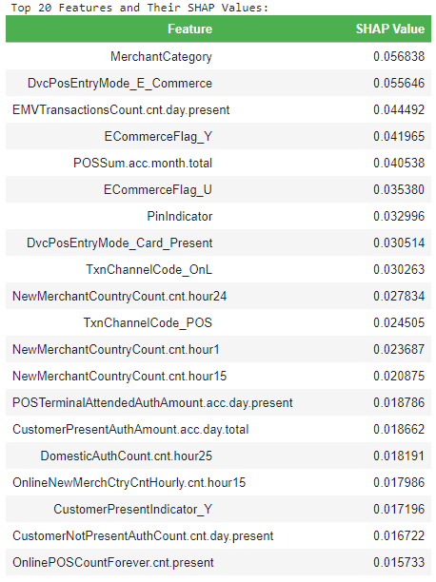
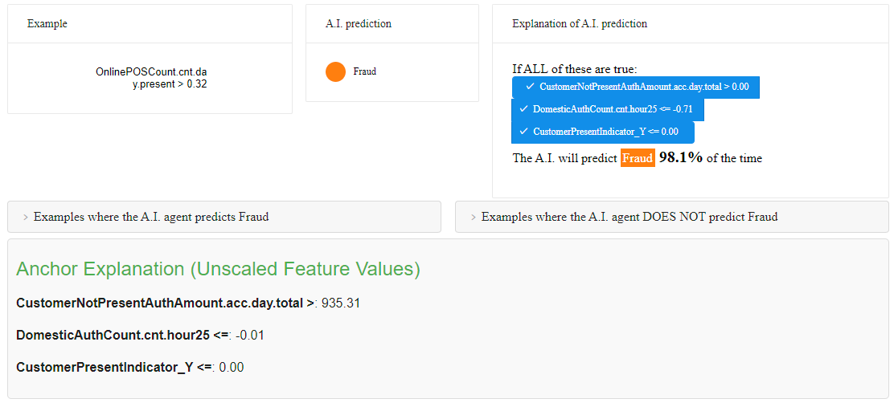
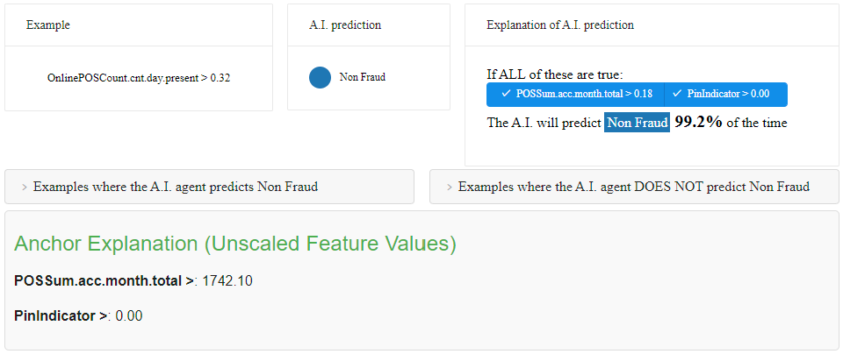
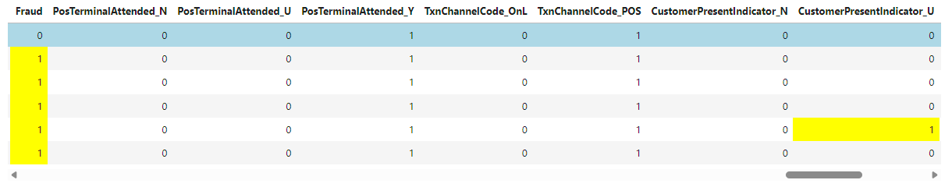
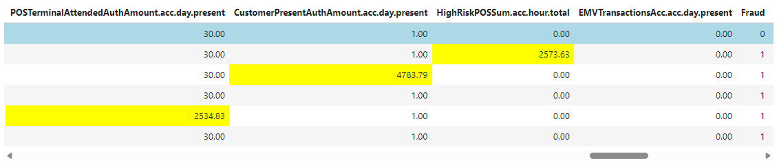
Pre-Experiment Question: Meaningful XAI Output?
LIME
SHAP
ANCHORS
DiCE
Notes:
On click brings you in TRANSITIONS do the rest.
Briefly coming back to the point that, before running the metrics experiments proper, I carried out a manual verification that XAI outputs generated on my data were meaningful.
No point having bad data going into the metrics.
I had to create my own visualisations on the ANCHOR and DiCE output to handle reverse scaling and better visibility on the counterfactuals. I did run into some problems at this point but I will come back to that before the end of the presentation.

Slide 21
Experiments: Results
What do the experiments reveal?
Notes:
So, I did confirm that the interpretability techniques would work with my data…and I could generate the metrics score… NEXT SLIDE

Slide 22
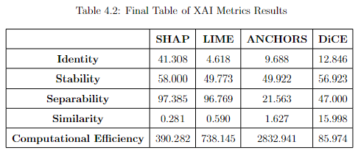
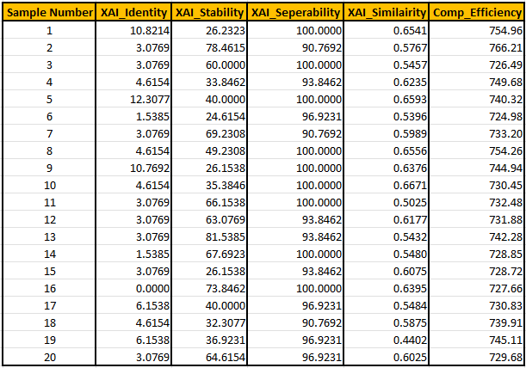
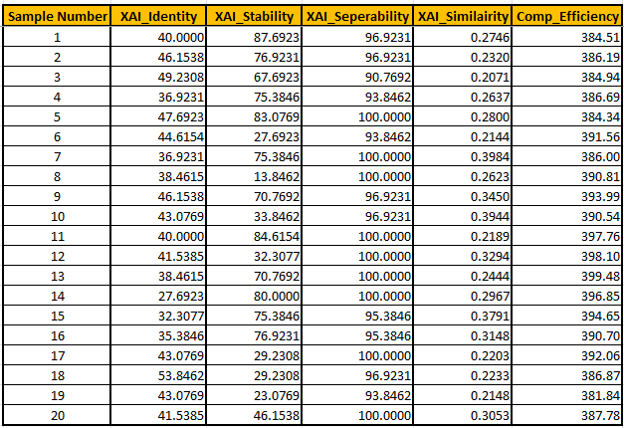
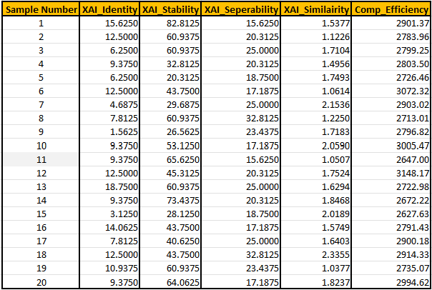
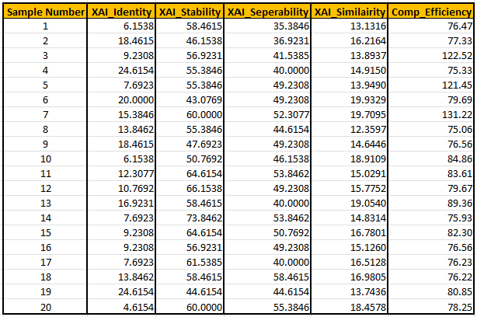
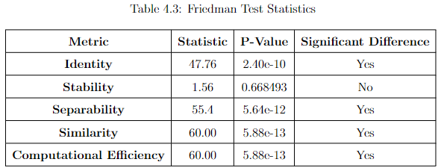
XAI Metric Scores
These experiment results confirm the NULL Hypothesis that the XAI methods do differ significantly in their performance for all metrics, apart from ‘Stability’.
Any ranking would be dependent on weights that users would apply to the custom metrics.
Notes:
Just move onto slide and it’s all transitions…
So, test data was broken down into 20 blocks and hence I got four sets of results against those blocks – as I said I will elaborate very shortly on why I chose to break the input Test Data up like this
The results for each metric for each XAI technique was averaged and then analysed to see if there is a statistical difference…which I could determine that there is NOT, confirming the NULL Hypothesis

Slide 23
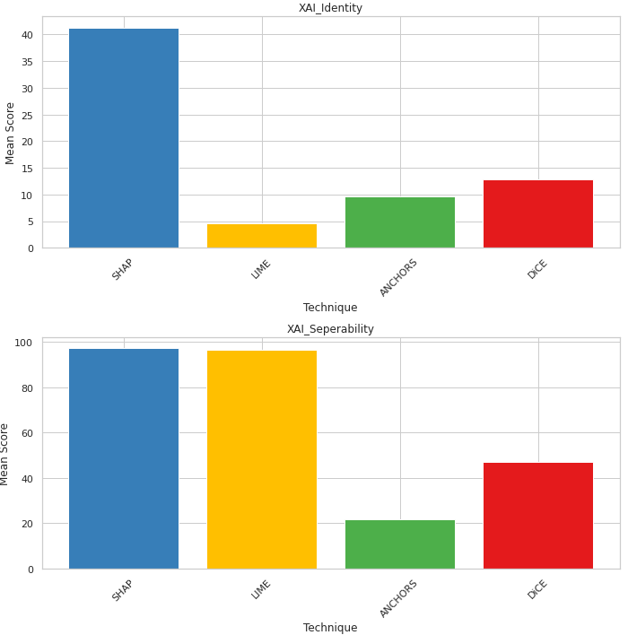
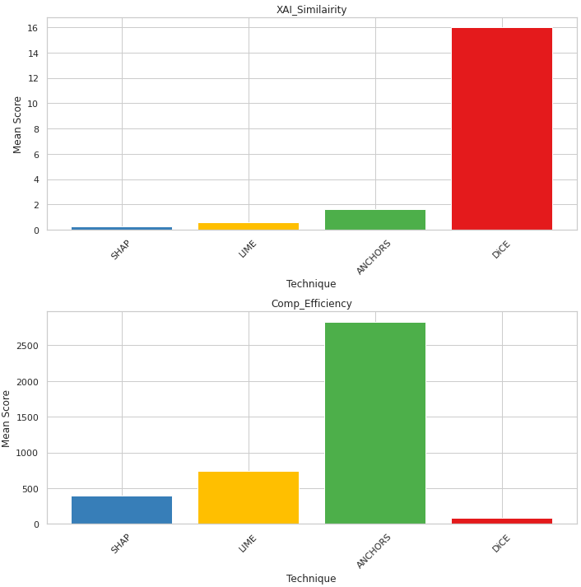
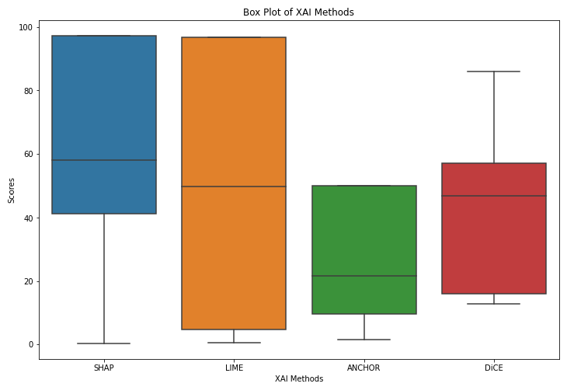
Statistical Analysis of XAI Scores
The SHAP technique generates a value for all instance features, but the other methods only cover a subset of attributes. This appeared to impact on the ‘IDENTITY’ Scores.
ANCHOR output is usually quite sparse. Explanations score poorly in distinguishing themselves from each other - ‘SEPERABILITY’.
Euclidean distance between some DiCE counterfactuals are significant, hence the poor score in ‘SIMILARITY’.
The computational overhead on ANCHORS is a significant output result, but only a subset of instances contribute to the high score.
Notes:
TRANSITION in…Elaborating here a little further on the statistical analysis, but also want to pick out some of the main experiment observations….
Click and talk to each bullet point…
Identity scores poorly for all XAI methods, with the exception of SHAP. This was arguably the most straightforward metric: similar instances should have similar explanations. However, the SHAP technique provides a score for all instance values, while the other methods generate explainers that cover only some instance attributes. This does not invalidate the use of this metric, but it is a key consideration when evaluating this research. IDENTITY: Distance between most similar instances = Distance between associated explanations.
ANCHORS is one of the methods that produces relatively sparse output (only one feature might be classified as an 'anchor' in the classification result). Thus, the explanations score relatively poorly in distinguishing themselves from each other (\textit{Seperability}). SEPERABILITY: Dissimilar instances must have dissimilar explanations
DiCE: The magnitude of counterfactual explanations for different individual instances can vary significantly. Hence, the DiCE method produces outputs where the Euclidean distance between separate explanations can be significant. This characteristic explains the higher DiCE score for \textit{Similarity}. SIMILARITY: The more similar the instances, the closer their explanations are to each other.
All custom metrics were designed and implemented to score a range of traits across the XAI methods. A poor score on one metric is often balanced by better performance on other metrics. The research appears to have applied a balanced assessment framework for use in these experiments.
STABILITY : Instances belonging to the same class have comparable explanations? Instances/Explanations cluster in same ‘Fraud’/’Non-Fraud’ clusters.

Slide 24
Contribution + Impact
What insight do the outcomes provide?

Slide 25
Contributions and Impact
The experiments were successful in building an objective statistical framework to compare XAI methods, but…
Would it be enough to convince a financial crime Product Manager to forgo human-centric survey? Perhaps, but the scope of the experiments needs to increase.
If SHAP has no obvious competitor for ‘good’ explanations – why keep looking?
Will the benefit of some XAI explanations, like Anchors and DiCE, always be ‘in the eye of the beholder”?
Notes:
Read the first line as is…
To convince a Product Manager, we would need more datasets and more XAI techniques…
On the last point, I very deliberately choose not to go down the route of a human-led survey for this thesis, but when one looks at the output from ANCHORS and DiCE there is an argument that this information would be really most useful when being interpreted by a credit card fraud investigator.
However, I am going to come back to that last point in my conclusions.

Slide 26
Contributions and Impact
Also…
“Context is for Kings”
The interaction of the XAI methods with the credit card dataset must be to considered in parallel with the custom metric results.
For example;
Why did Anchors take so long to compute?
Why did DiCE require additional features?
Notes:
Also…context is important; what did the experiments tell us about the interactions of the XAI techniques with this ‘real world’ credit card fraud data…?
ANCHORS took many hours to run; and would not generate outputs at all unless the input test data was broken into chunks – mention fact about 5% of data – this would be commercially unviable even for batch processing.
DiCE to did not work at all on CC dataset after the initial feature selection process was completed and the model built. The number and relationship of binary values in the search space meant that no counterfactuals were produced unless the feature set was extended with additional continuous attributes. This is not degrade the model performance and binary counterfactuals were included in the output but it could be a consideration.

Slide 27
Future Work + Recommendations
Quo Vadis?
Notes:
Where would I go from here with the results of the Thesis experiment…?

Slide 28
Future Work and Recommendations
Broaden XAI methods to improve insight on how new explainability procedure perform on the credit card data.
The experiment structure provides an effective, consistent, and repeatable framework into which to ‘plug’ other interpretability techniques (LORE, ILIME, MAPLE, etc.), and new datasets.
Create new custom metrics to increase range of automated criteria designed to rate a ‘good’ explanation.
Feed combinations of XAI outputs into an LLM or LAM and assess merits of the human readable output (via survey).
Notes:
Mentioned already the broadening of the experiments with more data sets and more XAI techniques.
Create more custom metrics to increase range of criteria.
On the last point there is a veritable technological arms races going on right now between software vendors to incorporate Gen AI/CoPilot capabilities into Financial Crime products. I would suggest feed all the XAI outputs into a suitably prepared LLM to present a holistic explanation back to an investigator (might have to revert to human-surveys for that) – or even go so far as to use LAMs and propose the elimination of fraud investigators for certain tasks such as submitting disclosure reports to regulators (switch domain to AML maybe).

Slide 29

Questions?

Slide 30
Question preparations…
Can you find any literature or previous research to back up the DiCE Counterfactual problems with binary features?
Can you find any literature or previous research to back up the Anchors computational overhead problems?
Have a list of ‘sound bites’ for each custom metric to elaborate on its workings. Build into deck.
Related to above – why is each one different to each other?
Have explanation ready on conversion to numerical for each XAI technique.
Slight elaboration on results.
Get spec of Kubeflow Notebook
Notes:
Proximity. Intuitively, CF examples that are closest to the original input can be the most useful to a user. We quantify proximity as the (negative) vector distance between the original input and CF example’s features. This can be specified by a distance metric such as ℓ1-distance (optionally weighted by a user-provided custom weight for each feature). Proximity of a set of counterfactual examples is the mean proximity over the set. Proximity := − 1 k Õ k i=1 dist(ci , x).
(3) Sparsity. Closely connected to proximity is the feasibility property of sparsity: how many features does a user need to change to transition to the counterfactual class. Intuitively, a counterfactual example will be more feasible if it makes changes to fewer number of features
DiCE: Mothilal, S. A., R. K., & Tan, C. (2020). Explaining machine learning classifiers through diverse counterfactual explanations. Proceedings of the 2020 Conference on Fairness, Accountability, and Transparency. doi: 10.48550/arXiv.1806.08049 – followed this approach; including use of German Credit dataset.
Relative scale of features. –
Benchmarking Counterfactual Algorithms for XAI: From White Box to Black Box - Moreira et al 2022
Plausibility. This property is analogous to Actionability and Reasonability [39, 63, 64, 68, 81]. Counterfactuals that are plausible need to be valid, and the search process should yield logically plausible outcomes. As a result, immutable features should never be changed (such as religion and gender).
DiCE ensures plausibility, and therefore it can generate actionable and meaningful counterfactuals by constraining the space of sensitive features such as gender, race, etc.

